Slide 1
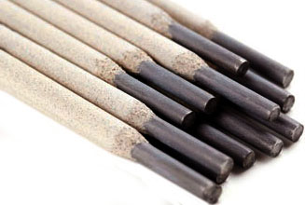

THE PROJECT LOCALIZATION OF ELECTRODES UONI 13/55
PROJECT NAME | PRODUCTION OF UONI 13/55 ELECTRODES
Project implementation period | 2019-2020 y.
Annual production capacity | 5 000 t.
Volume of investment | 550 thousand dollars. USA
Current volume of import | $ 18.2 million. USA
Reduction of import per year as a result of localization | 3.6 million USD
Localization percentage | 20 % (Twenty)
Creation of new jobs | 20 people.

